Slide 1
Team gun violence
File created on: 12/10/2020 1:11:35 PM

Slide 2
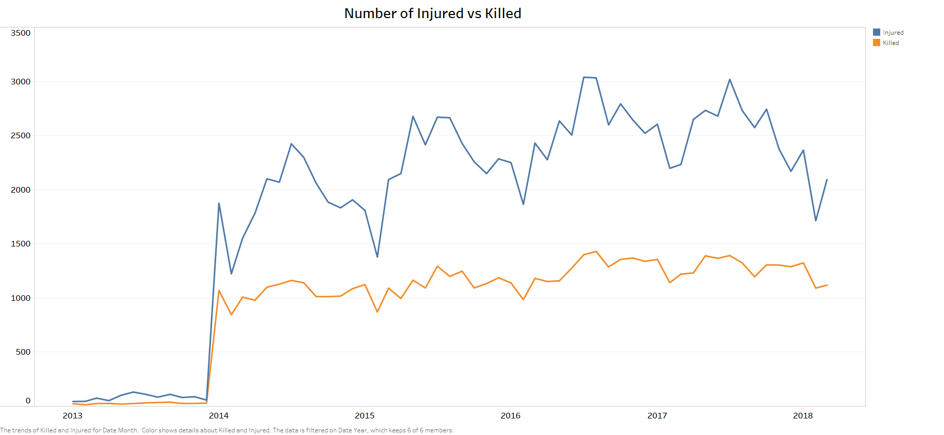

Slide 3
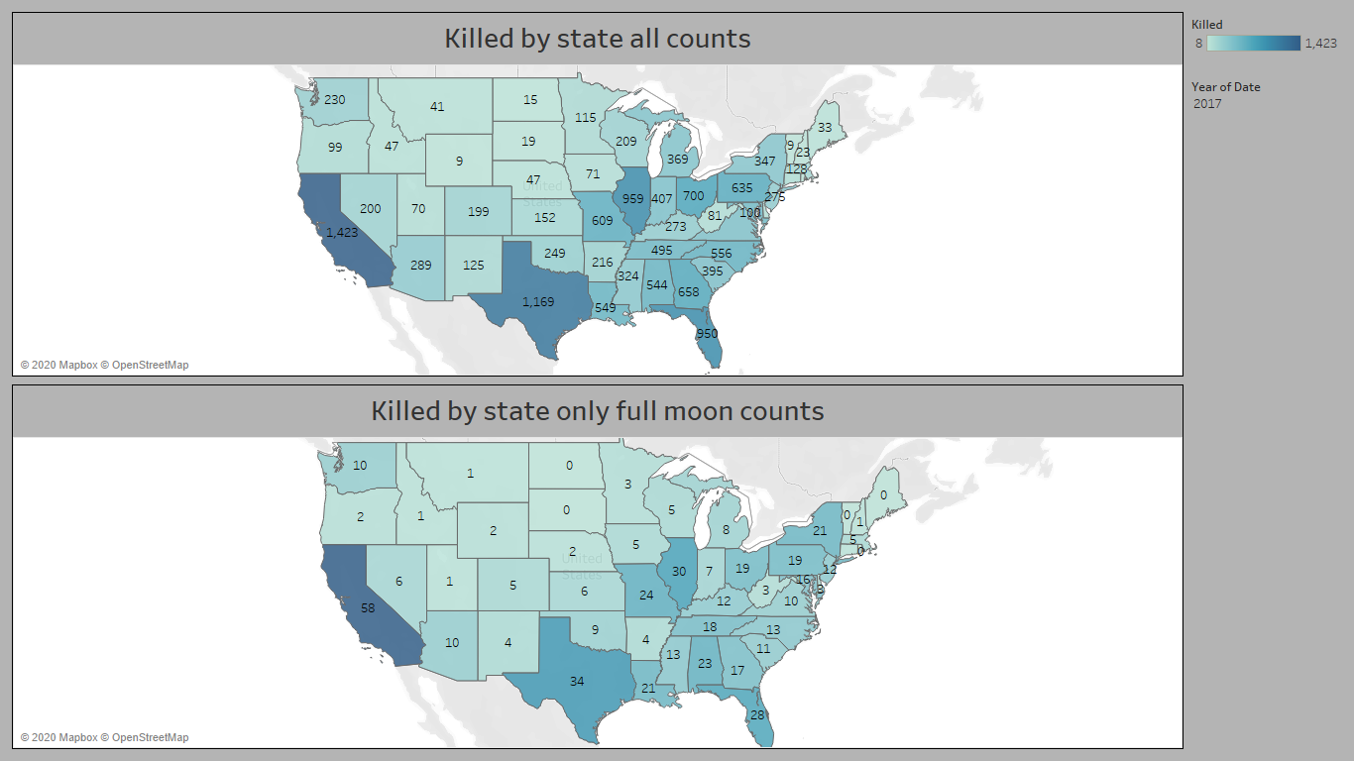

Slide 4
